Slide 1
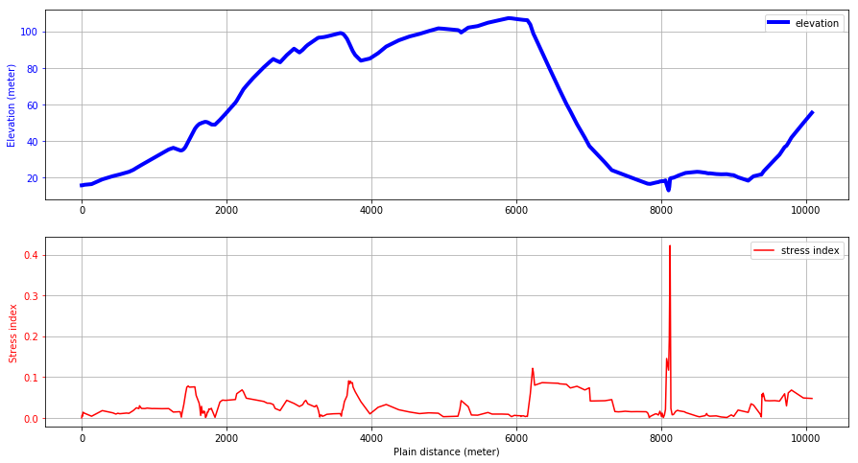
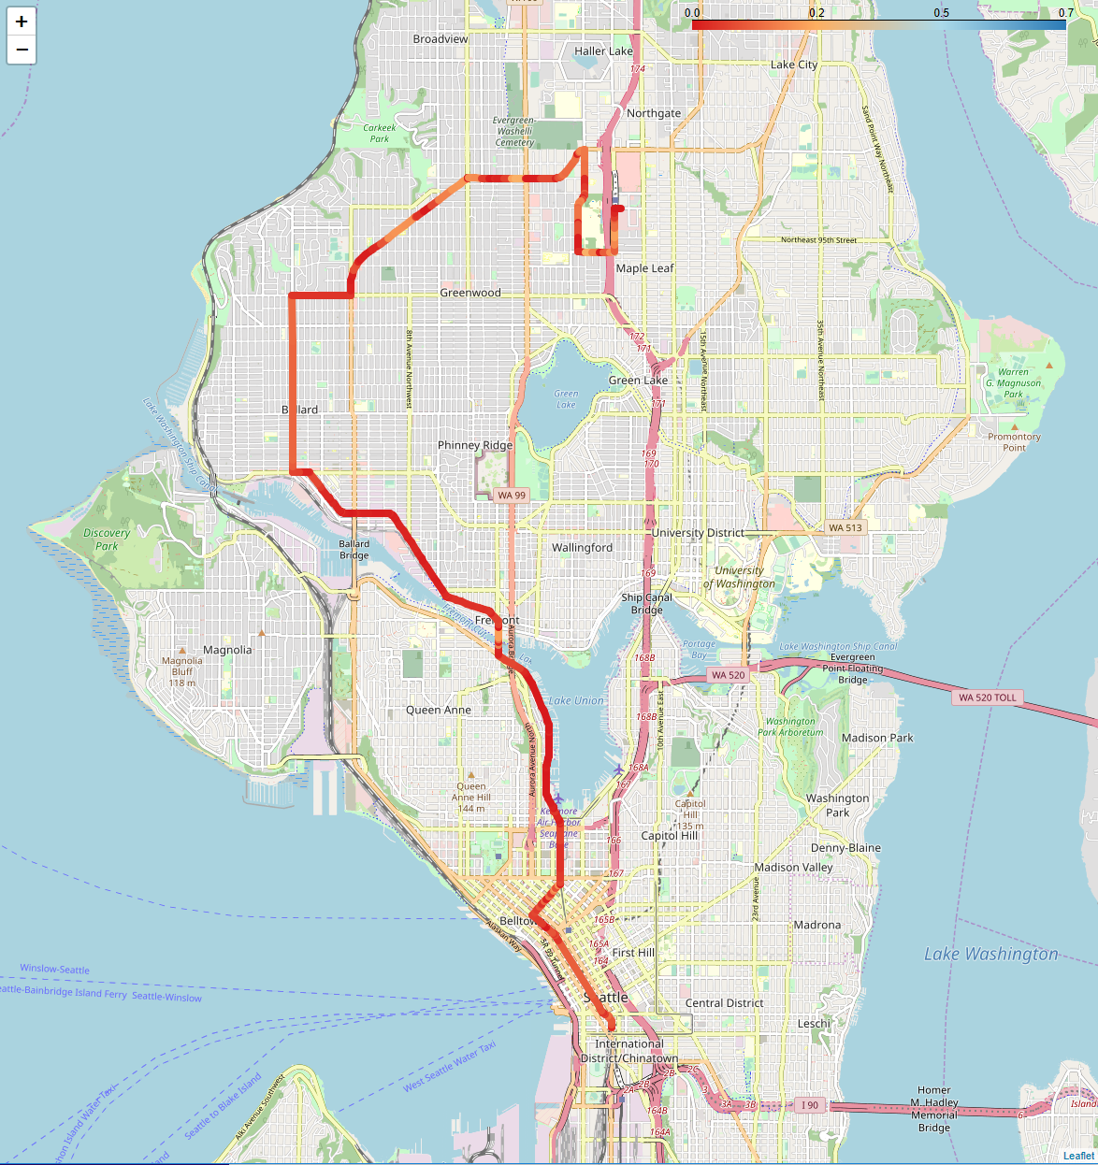
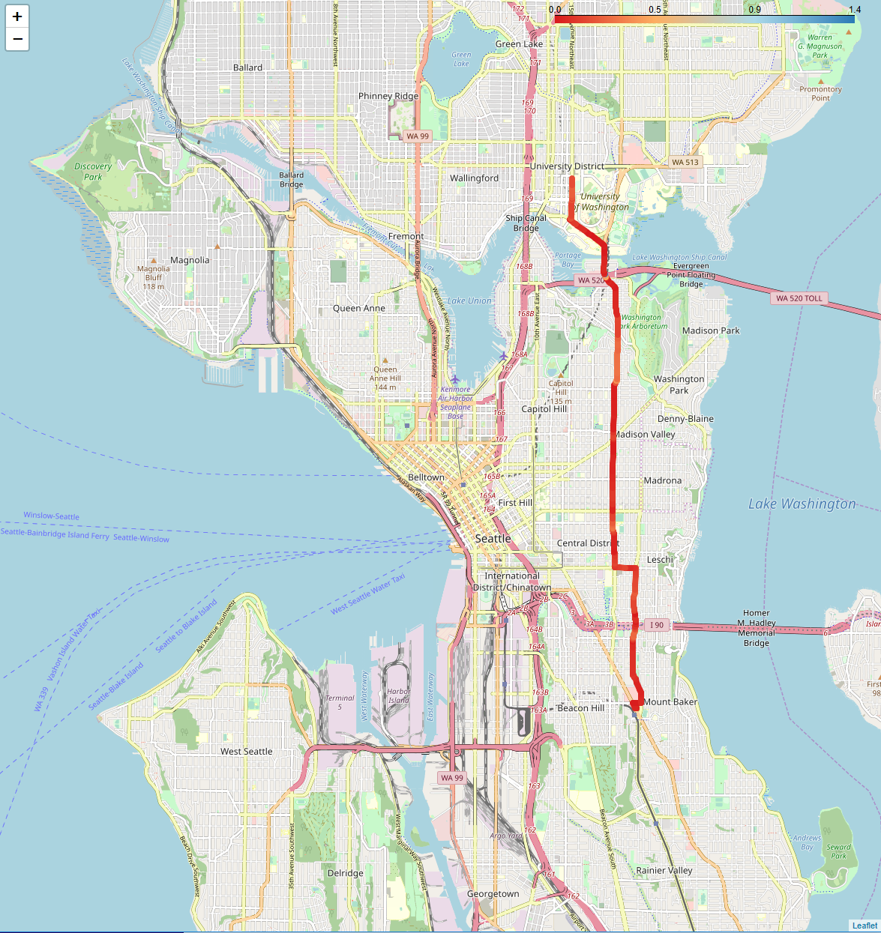
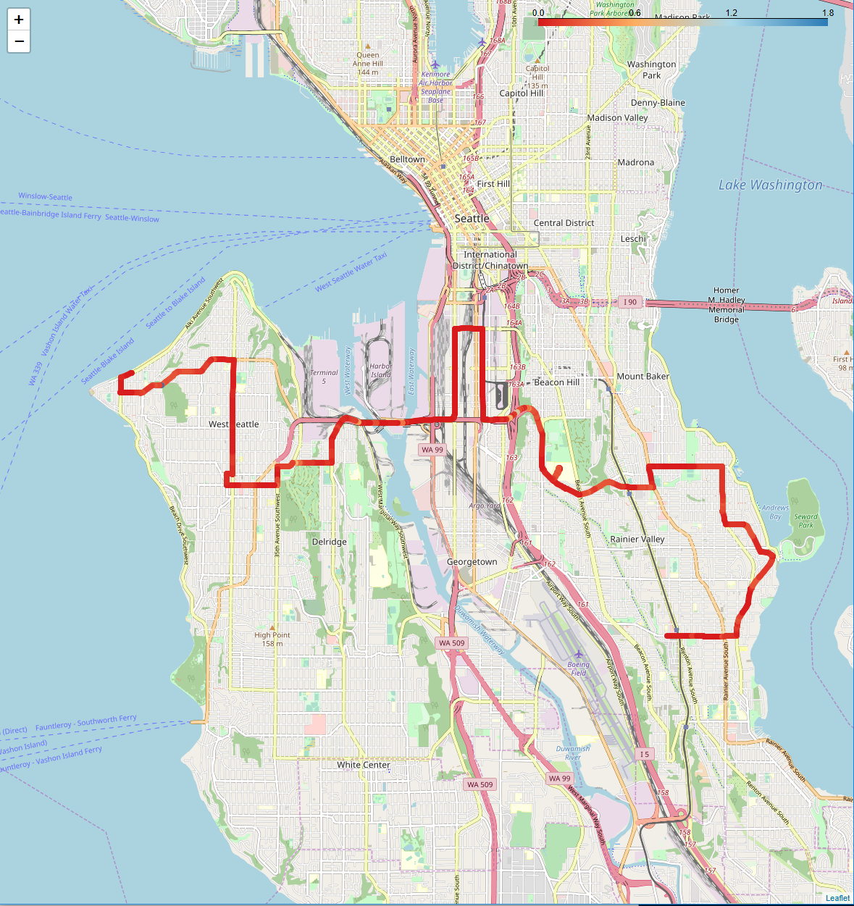
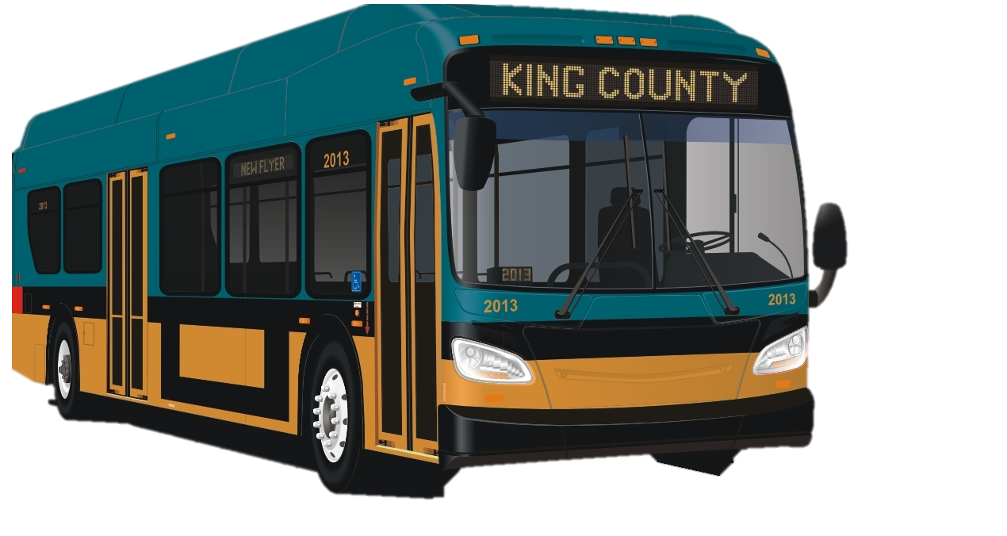
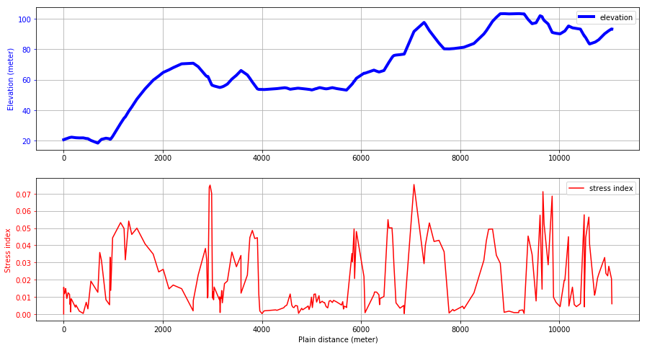
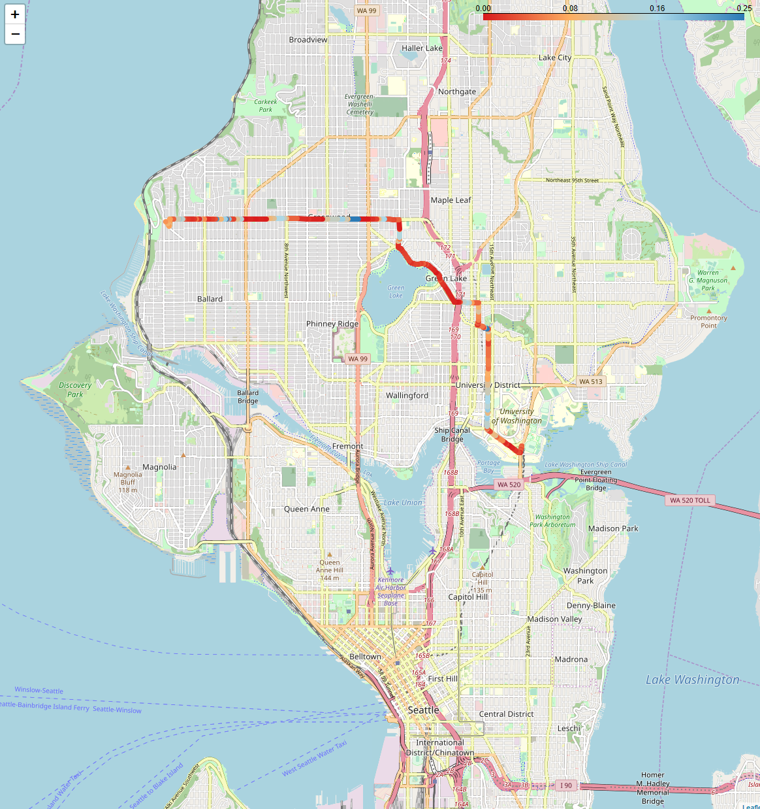
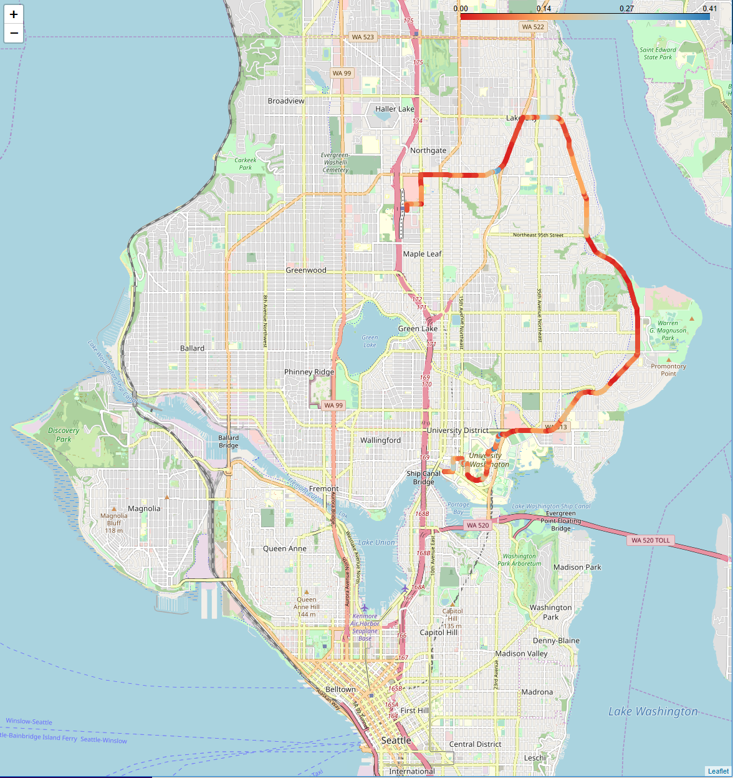
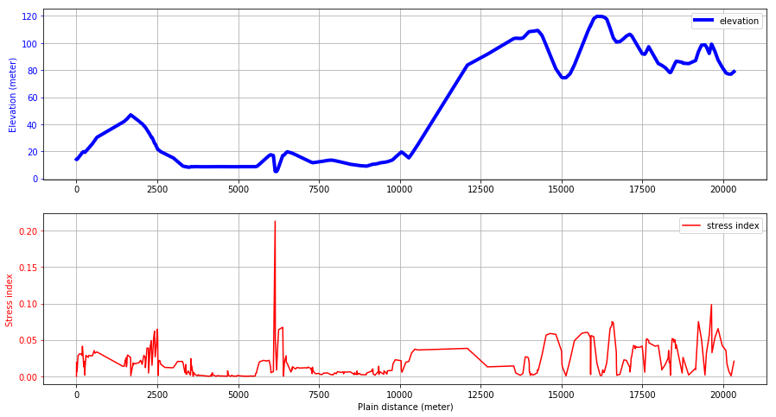
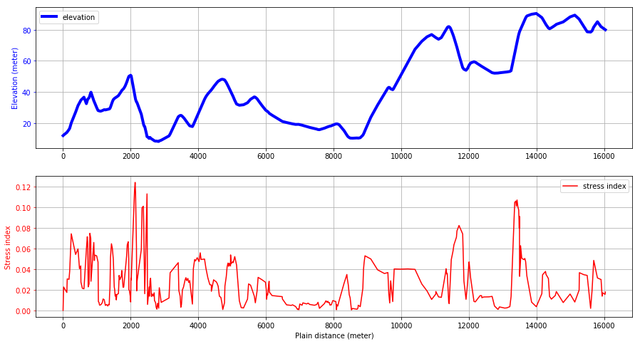
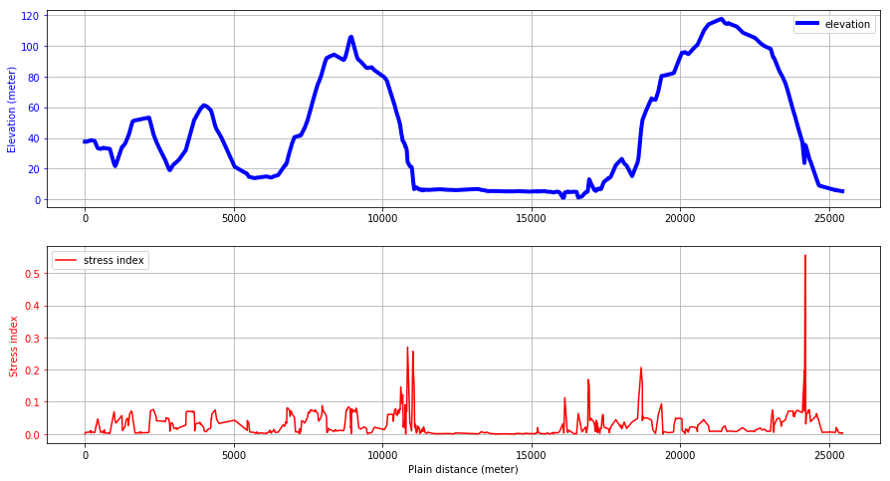


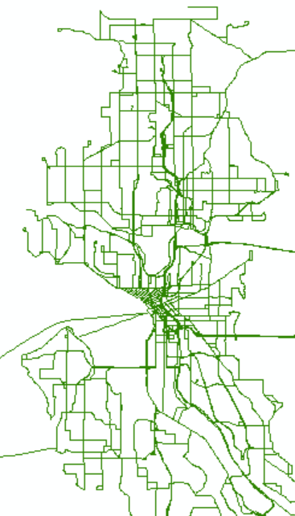
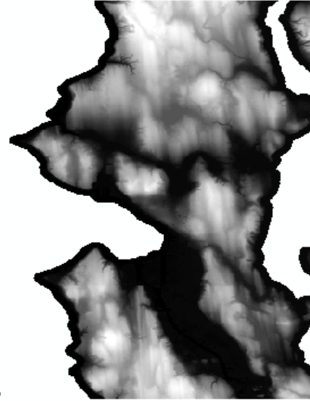
Route Dynamics: Visualizing King County Metro Bus Routes
Atinuke Ademola-Idowu, Erica E. Eggleton, Yohan, KM
Objective
Results
Driving up and down hills is a source of stress for batteries in electrified vehicles. This software uses geographic information systems (GIS) data to determine the elevation profiles for King County Metro bus routes and rank the difficulty with regards to the batteries.
Work Flow / Packages
Flow chart here
Current ranking metrics included in software:
1) Metric = sum(grade) / total route distance
2) Metric = sum(|Elevation distance between points|)/ total route distance
3) Metric =
4) Metric =
 | Method 1 | Method 2 | Method 3 | Method 4
Route 40 | 0.000330 | 0.021675 | 0.000169 | -0.000160
Route 45 | 0.000358 | 0.0222291 | 0.000204 | -0.000155
Route 48 | 0.000685 | 0.028796 | 0.000396 | -0.000290
Route 50 | 0.000684 | 0.027456 | 0.000333 | -0.000351
Route 75 | 0.000603 | 0.026726 | 0.000332 | -0.000271
Data Types / Cleaning
Routes were re-traced to avoid repeated points from multiple directions
Shapefile and raster file must use the same coordinate system.
Future Work
Add more parameters to get a better estimate of battery stress
Interpolate grade between points
References:
Bus routes: Shapefile (.shp)
Elevation: Raster file (.tif)

